Slide 1
Da Vinci Formulary IG

Slide 2
Background
The Formulary IG pre-dates the CMS Patient Access API and Interoperability Rule
Developed in April/May 2019, based off of CMS Qualified Health Plan (QHP) data model
When through early September, 2019 ballot
Formulary IG was published as an STU1 standard in January 2020, with almost no payer review (they didn’t attend any of the Da Vinci/HL7 meetings)
CMS Patient Access API and Interoperability Rule (CMS 9115-F) was released in March 2020
Formulary IG was designed as an open API, with no authentication, similar to Plan-Net (Provider Directory) API, with two use cases:
Accessing formulary information for the member’s current plan
Shopping across plans
Final Rule integrated Formulary with the Patient Access API, which is an authenticated API
The Final Rule 9115-F mandates accessing the formulary data associated with a member’s chosen plan
It does not require implementation of the shopping use case, but also does not prohibit it

Slide 3
Current Use Cases in Formulary IG
Non-authenticated

Slide 4

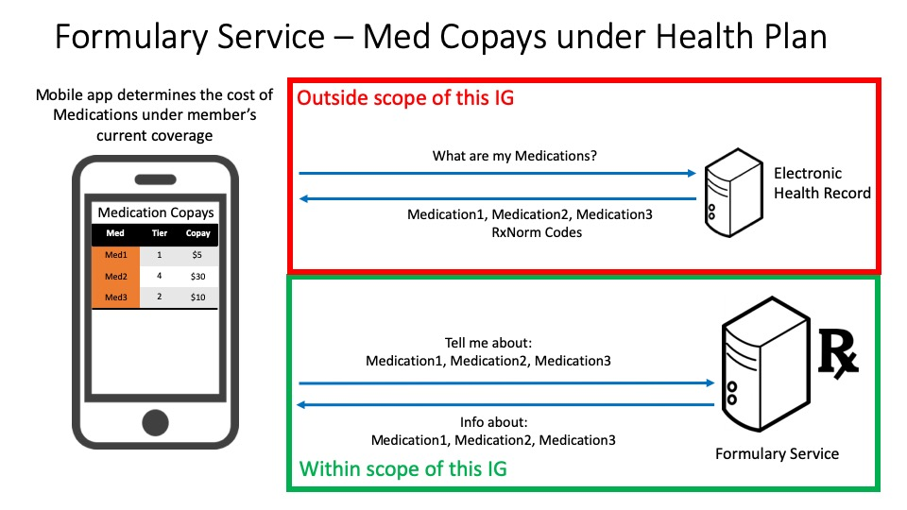
Plan Coverage and Medical Formularies

Slide 5
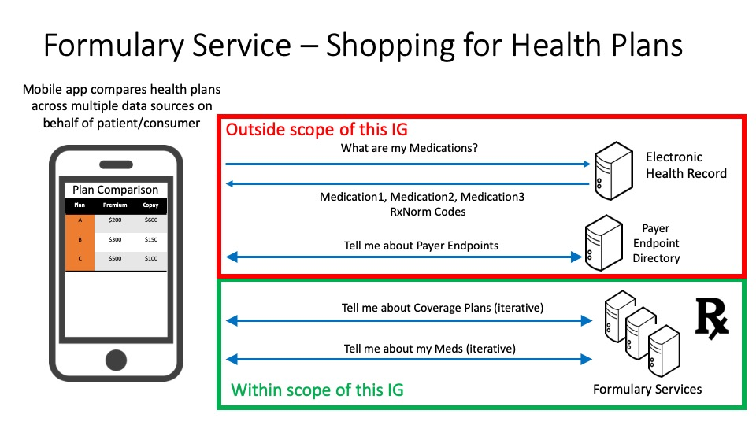
Plan Coverage and Medical Formularies

Slide 6
Authenticated Use Cases
Required by CMS Patient Access API and Interoperability Rule (CMS 9115-F)

Slide 7
Plan Coverage and Medical Formularies
Smart on FHIR-based transaction

Slide 8
Da Vinci and CMS seem to see value in the ability to shop plans
Want to leverage the capability for allowing shopping for health plans already supported in non-authenticated use case
Payers have raised several questions/concerns:
Payers do not want to show restricted (group) plans unless they know member is part of group coverage
Payers only want to display plans that are relevant to the member
Group vs Individual
Geography (e.g., Blue Cross Blue Shield of Massachusetts)
There are several variables that define what plans are returned to an authenticated member
Have they chosen a plan already?
Do they belong to a group?

Slide 9
Authenticated Member Scenarios
Authenticated Query from Client:
GET [base]/List?identifier=<planID>
Situation | PlanID specified | PlanID not specified (shopping)
No plan available | Zero plans returned (200) | Zero plans returned (200)
No plan selected/no group | Zero plans returned (or return plan like non-auth) | Bundle of available individual CoveragePlans
No plan selected/in group | Zero plans returned (or return plan like non-auth) | Bundle of available group CoveragePlans
Plan selected/no group | If PlanID matches selected plan, return CoveragePlan, otherwise zero plans returned | Zero plans returned. (This seems to be a special case that may not be necessary)
Plan selected/in group | If PlanID matches selected plan, return CoveragePlan, otherwise zero plans returned | Bundle of available group CoveragePlans. If no plans available, zero plans returned.
Once CoveragePlan(s) are retrieved, client application can retrieve the formulary for each CoveragePlan:
GET [base]/MedicationKnowledge?DrugPlan=<planID>
...or query across plans for coverage for a specific drug: GET [base]/MedicationKnowledge?code=<drugCode>

